Slide 1
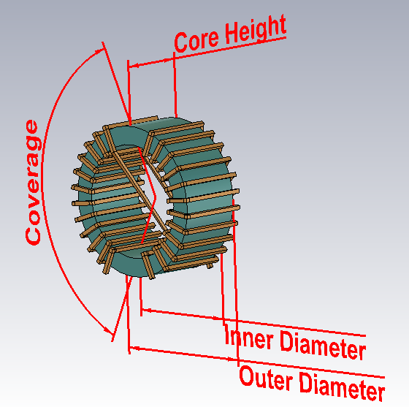
Generate CMC model with macros

Slide 2
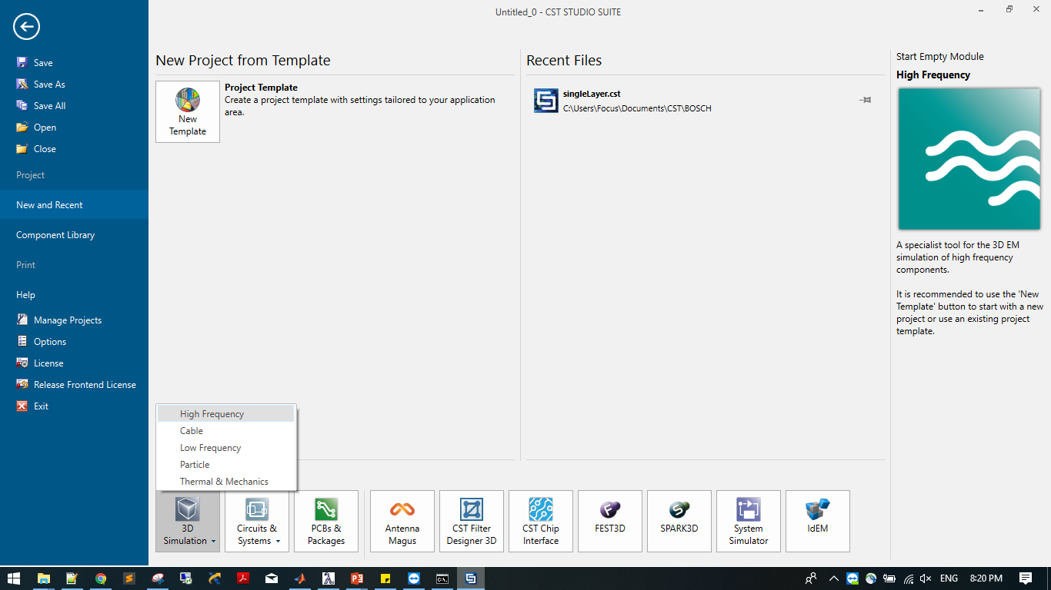
Start a completely new HF project

Slide 3
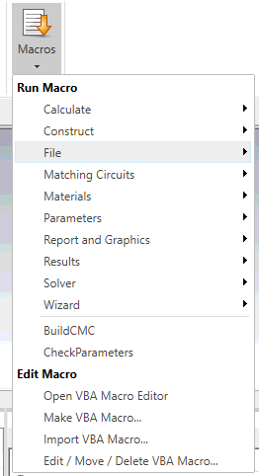
Import Macro, not open editor
After import, these two will show up on the list

Slide 4
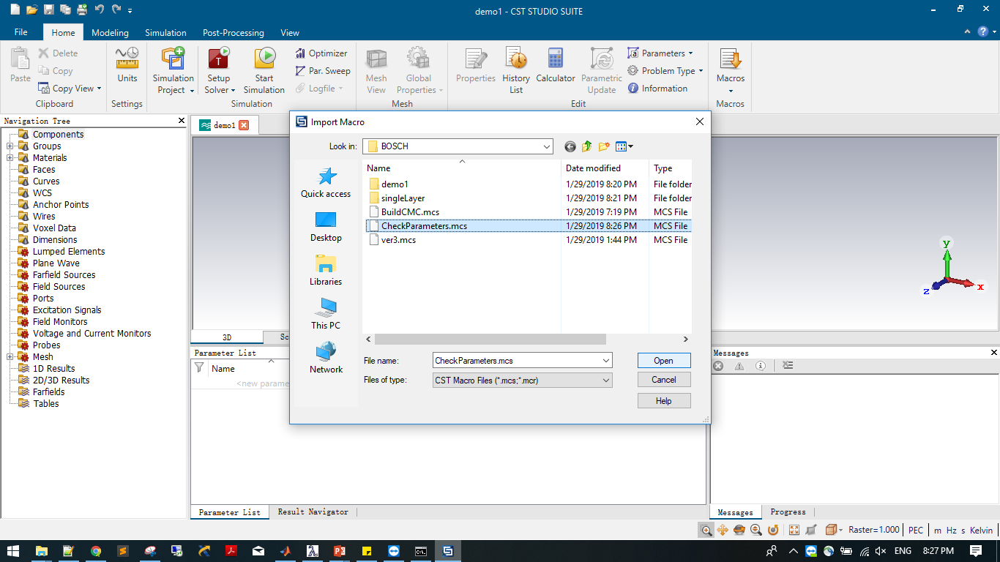
Import CheckParameter.mcs

Slide 5
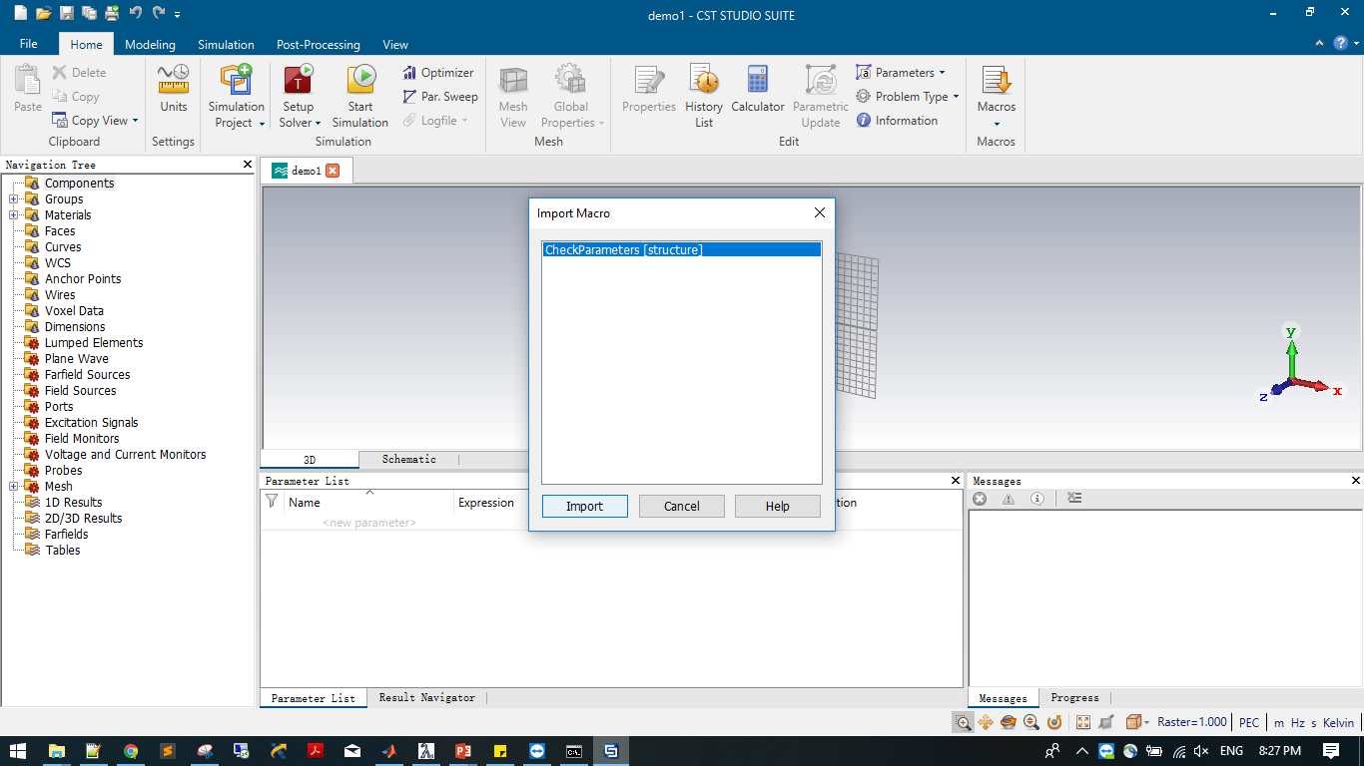
Import CheckParameters.mcs

Slide 6

Import BuildCMC.mcs

Slide 7
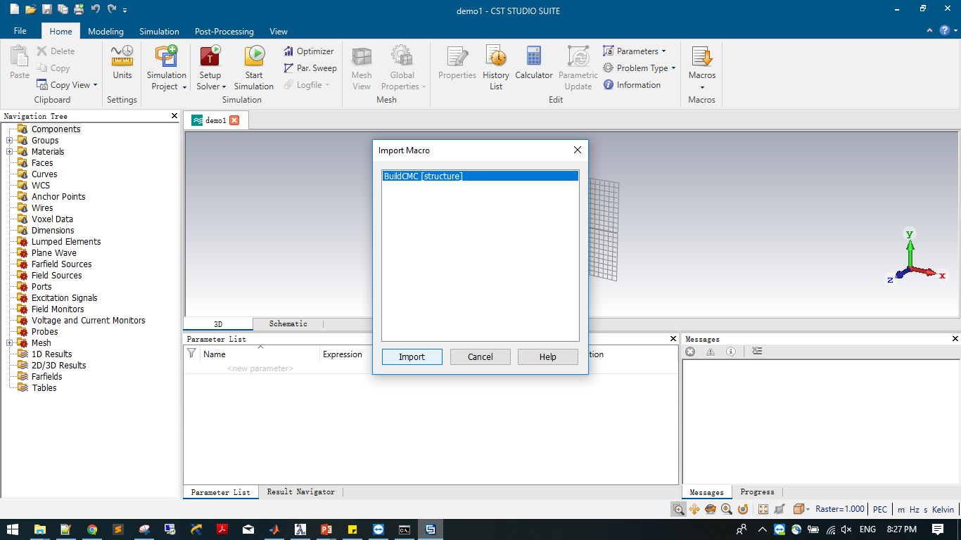
Import BuildCMC.mcs

Slide 8
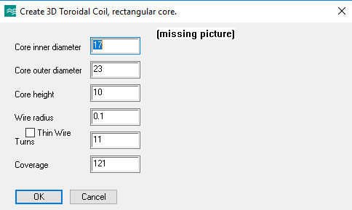
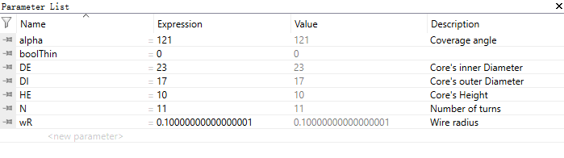
run checkParameters, from Macro dropdown list
 | Check | Uncheck
Radius>0 | Thin wire with radius | Square wire
Radius=0 | Thin wire, no radius | Thin wire, no radius
Run from here
A list will be generated, according to the parameters input into the dialog.
If all parameters already exist, the macro will still change the solver to frequency solver, and set units, then silently exit.
If any parameter is missing, the dialog will pop out.
Running checkParameters is not mandatory when all these 7 parameters already exist.

Slide 9
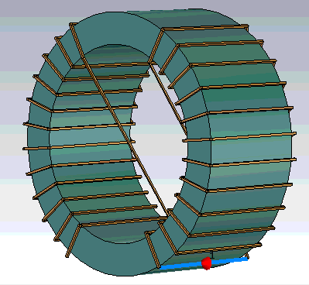
run BuildCMC, from Macro dropdown list
A CMC will be generated according to the parameters.
A port is already added.
But the insulation layer is not defined. Neither is the core material.
A thin wire model can be part of the parameter sweep as shown in the next video clip.
Overlapping wire detection is added in the code, but will only send out a message, won’t force the macro to exit. [the down right corner shows the messages]

Slide 10
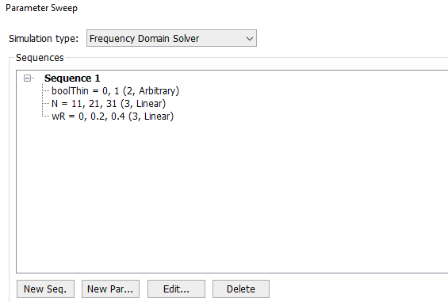
Parameter Sweep
The robustness of the macro is roughly checked. Extreme cases are not fully covered, but general parameter combinations are tested.
Alpha is double type, any value
boolThin only takes 0 or 1, to avoid error.
DI<DE-0.2 is required, they must be larger than 2*wire radius
HE is double type, HE>0.2 is required
The N has to be at least 3, integer type.
wR can be 0, or any larger float type.
The sweep check is recorded, shown next page.
Notice the switch between thin wire and square wire mode, and the intersecting wire warnings.
The constant 0.2 that appears in the constraint of parameters, is because of hard coded paint thickness 0.1mm

Slide 11
